Slide 1
IS 120
CSS Accessibility

Slide 2
Announcements
Dev Tool Demos are next class (March 9th)
  You should be using and getting familiar with your tools
HW 8 instructions will be posted after class
Project 2 instructions

Slide 3
Why Accessibility?
ADA (Americans with Disabilities Act)
Prohibits disability discrimination in all areas of public life. The web is considered public
In 2024, over 4,000 lawsuits were filed over web accessibility
Settlements range from $5,000 to $75,000
  Not including legal fees, redesign costs

Slide 4
Why Accessibility?
Understanding how to make a website accessible is a very valuable skill as a programmer
Many teams have no one who understands accessibility
Great differentiator to put your resume

Slide 5
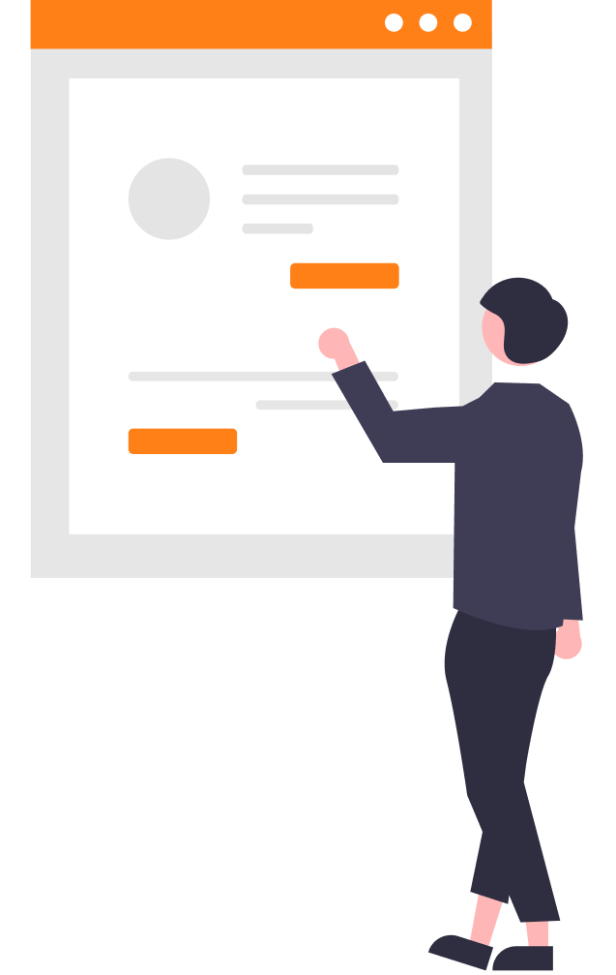
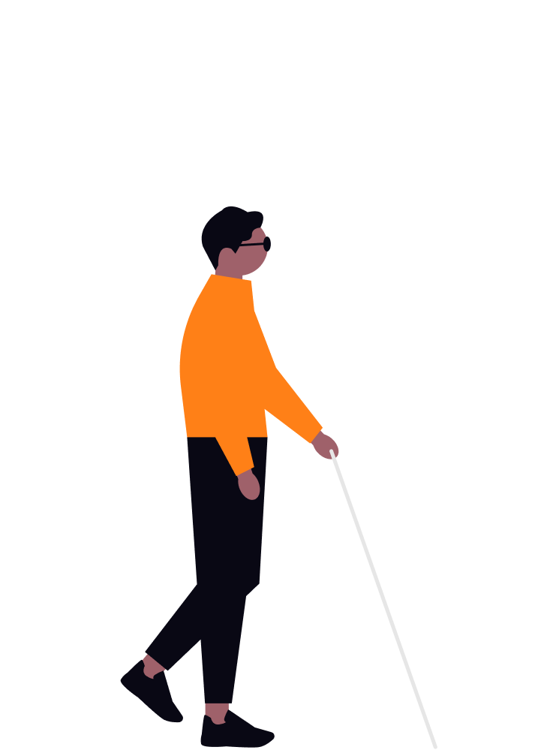
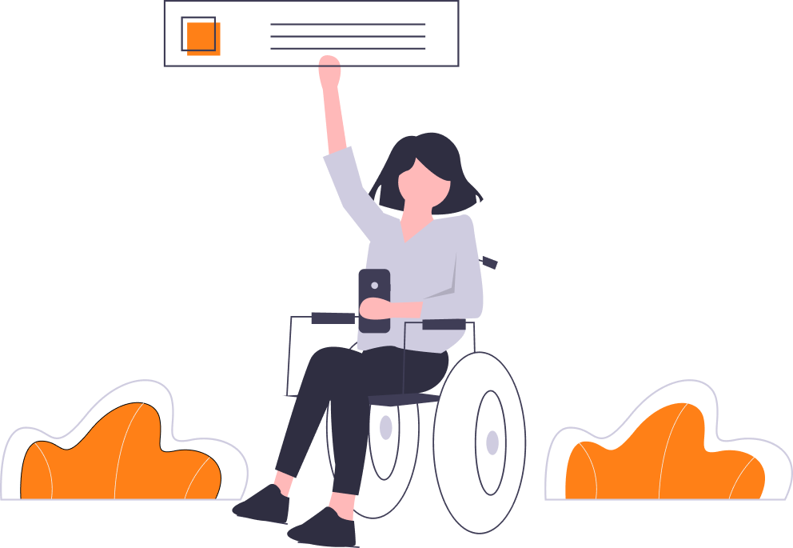
Why Accessibility?
Everyone uses the web in different ways

Slide 6
Recap HTML Accessibility
How to make websites accessible with just HTML?

Slide 7
Recap HTML Accessibility
How to make websites accessible with just HTML?
img alt
  Describe what the image is. Don’t include “picture of”
Semantic HTML
  Helps screen readers understand the page structure

Slide 8
Recap Relative Font Sizing
You should be using rem and em for font sizes
px will not scale with a user’s font settings
Demo

Slide 9
Color Accessibility
WCAG (Web Content Accessibility Guidelines)
  Standards that help evaluate the accessibility of a website
Contrast is not only an important design principle, it will make your website easier to read
Never use color alone to convey meaning
  E.g. A red error message should also have an alert icon

Slide 10
Color Accessibility
WCAG Contrast Checker
  https://webaim.org/resources/contrastchecker/
Website examples

Slide 11
Color Accessibility
WCAG Contrast Checker
  https://webaim.org/resources/contrastchecker/
Example https://news.ycombinator.com/item?id=2222522
Get in pairs, find real website color pairs that don’t pass
  Only look for AA compliance failures

Slide 12
Color Accessibility
If you haven’t already, try the contrast checker on your Project 1 website
Tool to fix contrast issues
  https://accessible-colors.com/

Slide 13
Color Accessibility
Demo Color Blind Web Page Filter
  https://www.toptal.com/designers/colorfilter

Slide 14
Keyboard Navigation
Users with motor disabilities need to be able to navigate a website without a mouse
This can be accomplished through keyboard navigation, using Tab, Shift + Tab, and Enter
You can modify these styles using focus-visible, but we won’t cover that in this class

Slide 15
Keyboard Navigation
Get in pairs
Find a product on Amazon and add it to your cart only using your keyboard

Slide 16
Keyboard Navigation
Get in pairs
Find a product on Amazon and add it to your cart only using your keyboard
What worked?
What didn’t

Slide 17
Google Lighthouse
An extension of Chrome Dev Tools
Audits a page for accessibility performance, SEO, etc.
Fairly extensive, but is not a 100% guarantee to make your website completely accessible
Demo Lighthouse

Slide 18
Google Lighthouse
An extension of Chrome Dev Tools
Audits a page for accessibility performance, SEO, etc.
Fairly extensive, but is not a 100% guarantee to make your website completely accessible
Demo Lighthouse
Get in pairs, run Lighthouse on your Project 1

Slide 19
Prefers Reduced Motion
Intense animations can cause dizziness or seizures for some
prefers-reduced-motion media query
  Tone down or completely turn off animations if needed
Demo

Slide 20
Spinner Animation
Pair program
https://css-loaders.com/spinner/

